Slide 1
SUSTAINABILITY
Bengt Grønås
Cloud Management Specialist Norway, Denmark, Sweden, Finland & Baltics
tirsdag 26. september 2023
Notes:
Click to add notes

Slide 2
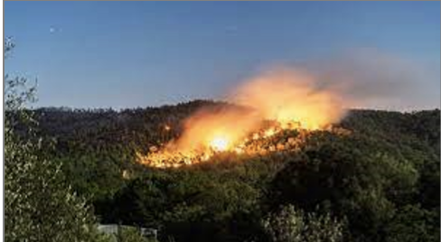
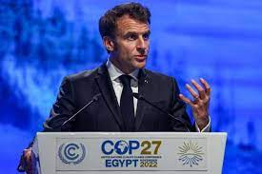
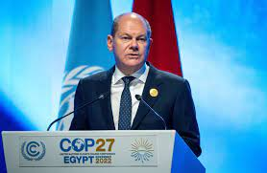

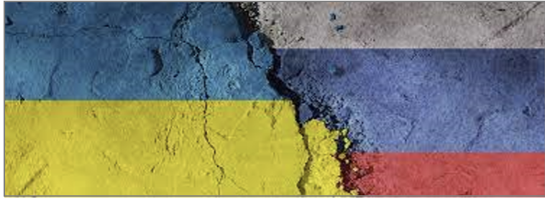
The bad news
Current Context
"Who could have predicted the climate crisis and its spectacular impact on our country this summer? Climate change has been even faster than expected. We need to double our efforts.
“Europe as a whole is suffering from the high prices of natural gas and I am convinced: We can overcome the crisis only with solidarity,”
"Fighting climate change is not just a moral good - it is fundamental to our future prosperity and security.”
Notes:
Se på Nyhetene. Global warming perspective
Sustainability is most often related to carbon reduction, but…
Energy Crisis, a bit better this year, but maybe a band-aid?

Slide 3
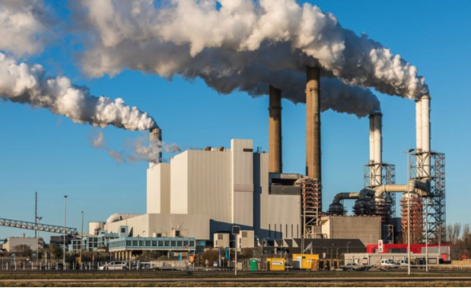
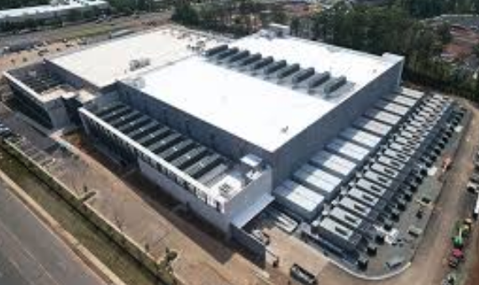
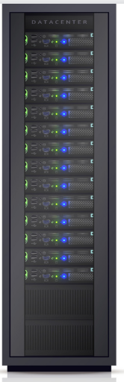
IT System Energy Flows
65% (generation &
grid system losses)
43 MWatt
33% losses (cooling)
15 MWatt
10 MWatt
Power Plant
Data Center
2,000 server racks
Notes:
You’ve probably never thought too much about the upstream end of your cloud and data center operations power consumption. In this example, 2,000 racks of IT infrastructure at about 5 KW per rack needs 10 megawatts of power. This equipment is housed in a data center that uses another 5 megawatts to cool the servers for a total of 15 MW.
That data center is in turn, powered by a power plant. And depending on the type of power plant, whether a coal, natural gas, nuclear, hydro, solar or wind, on average, due to generation and transmission losses, about 43 MW of fuel is needed to power that IT equipment. That’s the power required for a city of about 30,000 people!

Slide 4
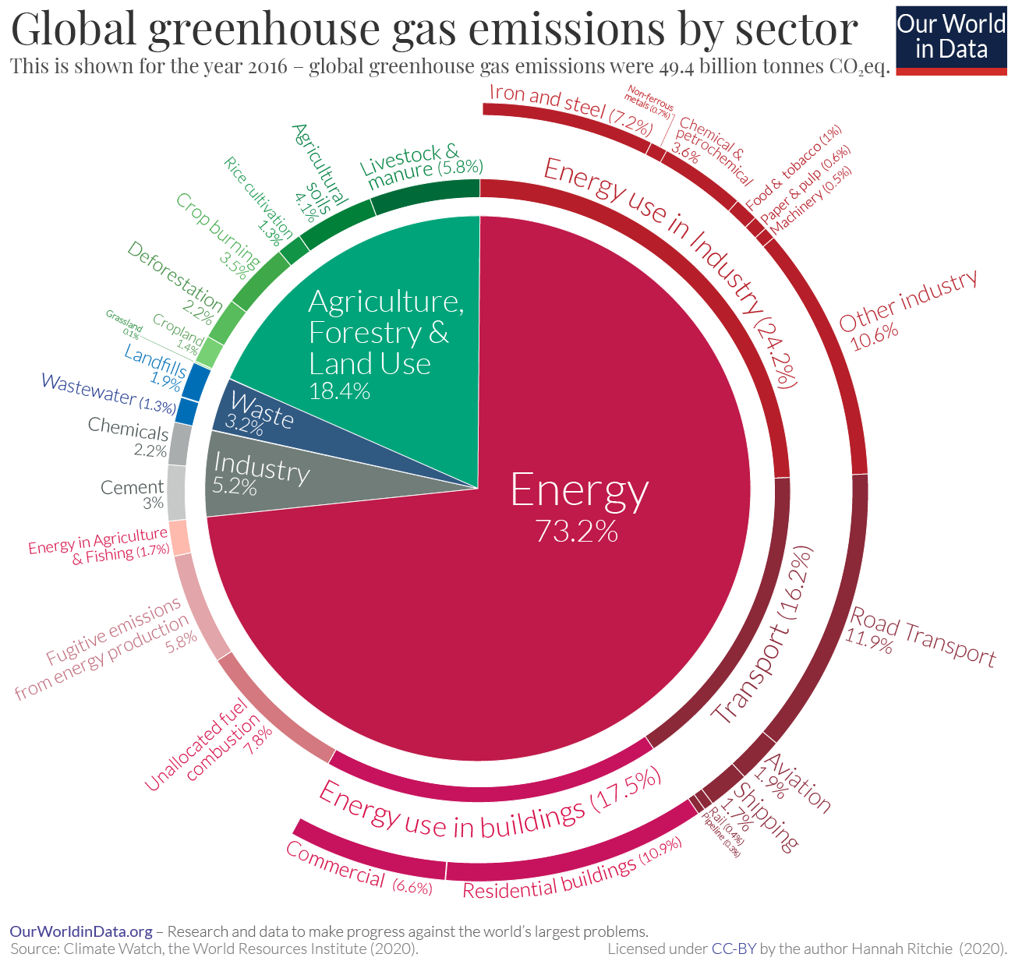
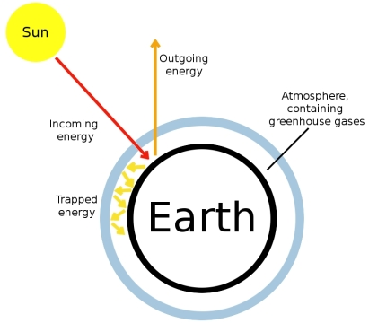
The Greenhouse Effect and the Digital Impact
The Digital Industry
Consumed more than 2% of the world’s electricity.
Emitted as much CO₂ as the airline industry.
Rapid growth, 6% annually
Datacenters are responsible for 10 -15%
Network (Antenna and data transfer) = 25 – 30%
User devices = More than 50%
Srce: https://en.wikipedia.org/wiki/Greenhouse_effect
Notes:
BAD BOYS
Building industry
Steel industry
Energy customers
Switch from traditional energy resources
Energy consumption across industries – especially across process manufacturing, buildings and transport is still the most important topic to address
Most if not all of our customers have ESG targets in their 2023+ plans and transformational budgets have been agreed to accelerate the journey towards Net Zero
In many industries, Scope 3 – i.e. CO2 reduction beyond core operations, is the most difficult one to report on and change, but key to CO2 reduction overall (eg the use of products in households, the wider aspects of e-Mobility, the use of chemicals in the extended value chain)
Understanding our customers’ efforts and challenges in CO2 footprint and reduction targets helps position VMware as part of the Net Zero journey
Emissions by sector - Our World in Data (;last refresh of data in 2022)
Press conference slides FINAL_PDF (ipcc.ch)
Just 25 French Firms Produce 8 Times France’s Carbon Emissions: Study (forbes.com)

Slide 5
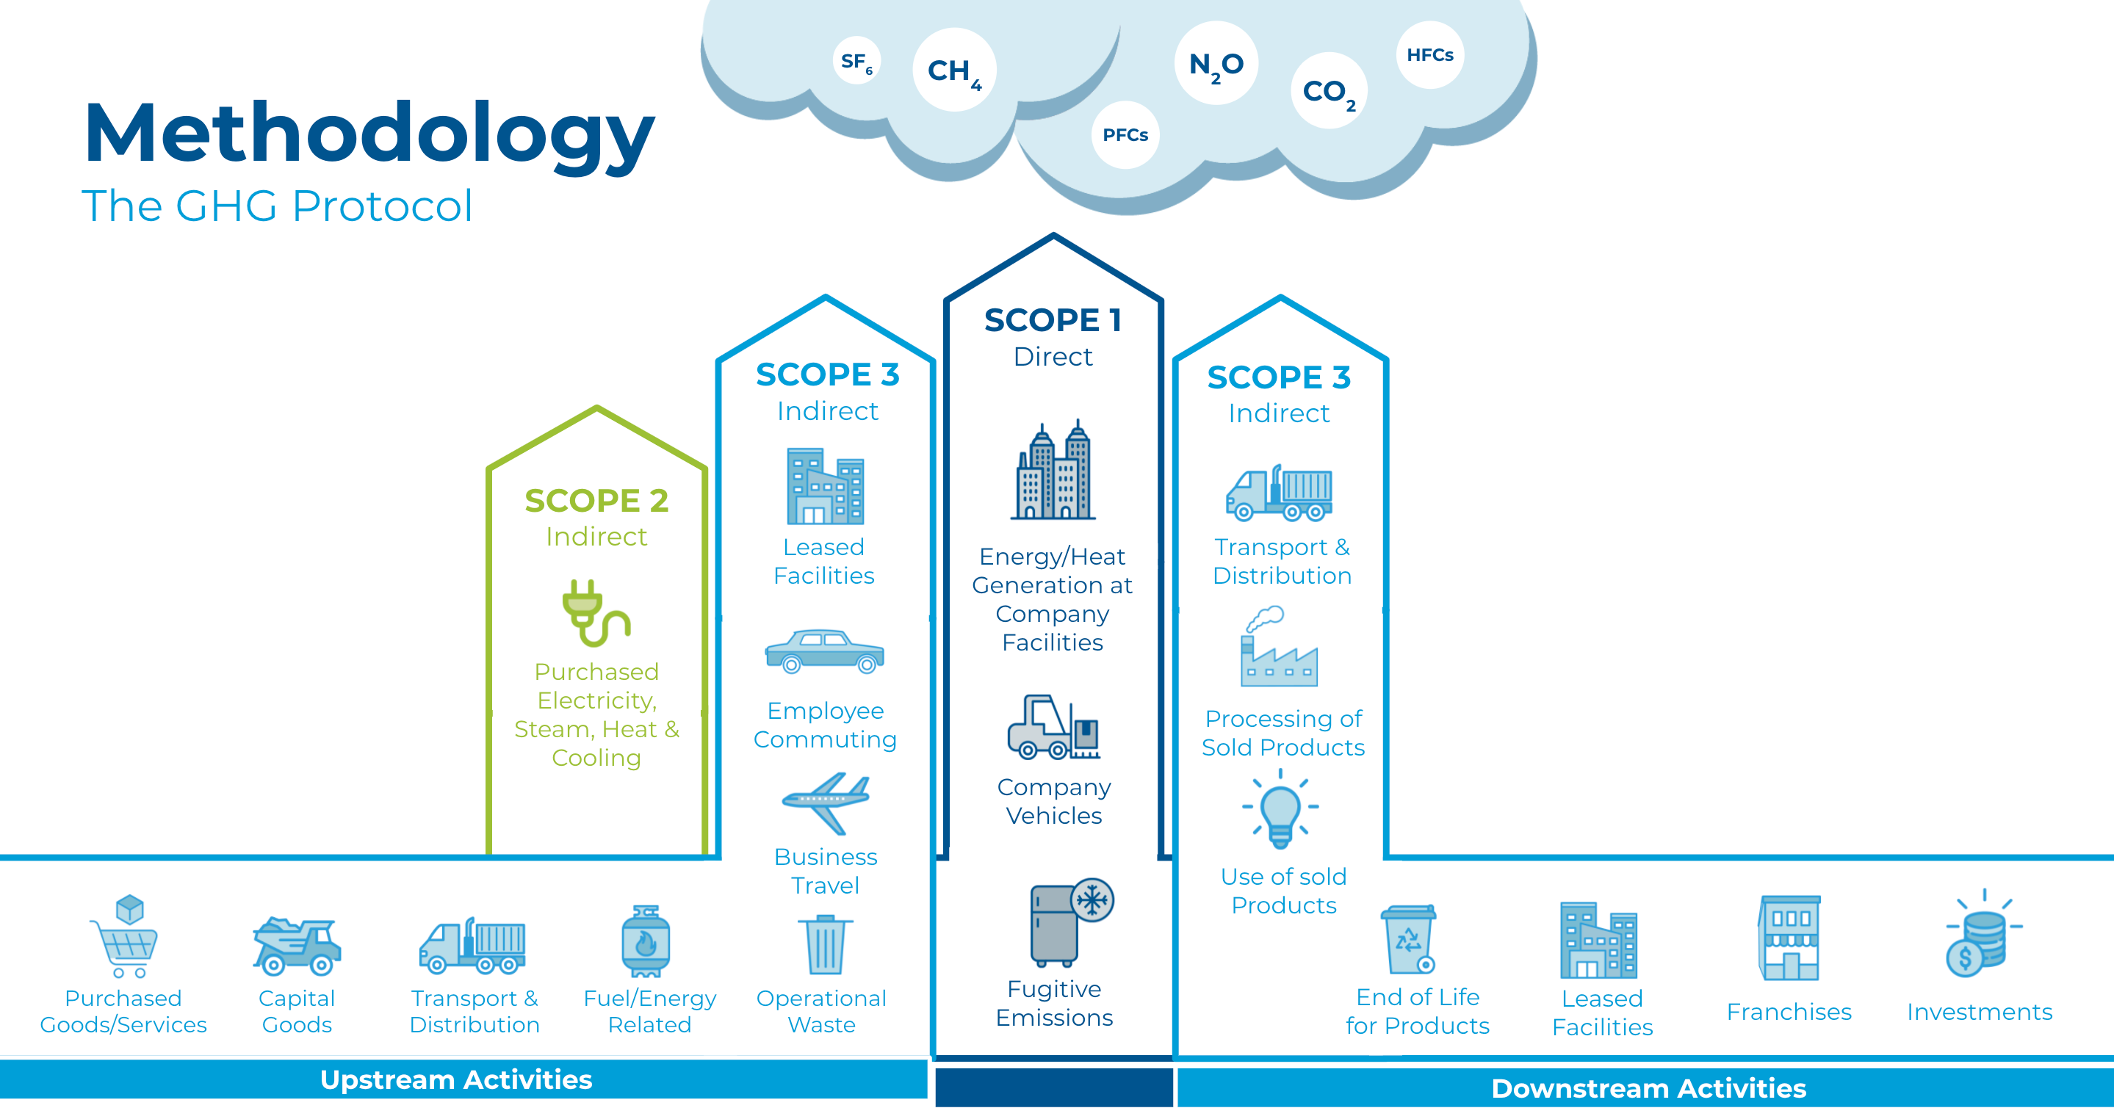
Methodology
The GHG Protocol
Notes:
Green House Gas protocol = GHG
CO2 Equivalent = CO2e
in scopes
3: kjøp av servers, bygging av servere
Vmware kan hjelpe med SCOPE1: ref. Horizon
Oftest er det I SCOPE2:

Slide 6
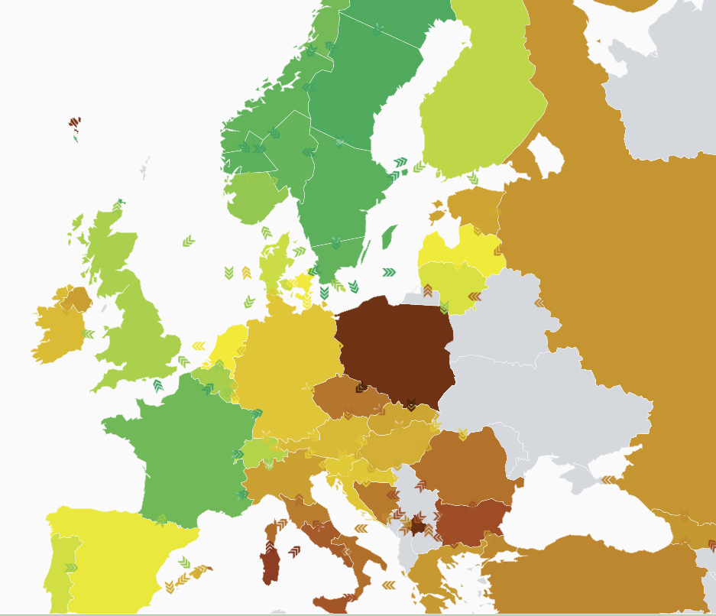
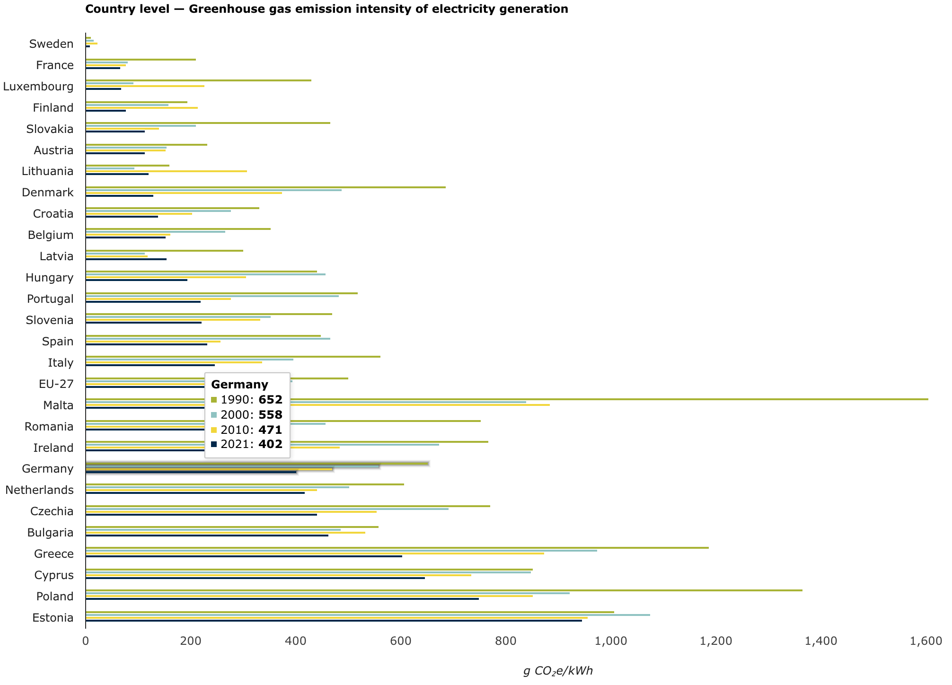
Scope 2: Carbon Intensity is a Big Deal
Real time
Over the years
Srce: https://app.electricitymaps.com/map
https://www.eea.europa.eu/data-and-maps/daviz/co2-emission-intensity-12/#tab-chart_2
Notes:
Carbon Intensity… HOW Clean is your electricity!!
Depending on location and climate, many new sites are designed to below 1.20 at full load.
https://sustainability.equinix.com/environment/operational-efficiency/
Se på Polen, Frankrike, Tyskland
Zoom ut på verden. China, US
NOTE: Location where the application is located is important !!!!!

Slide 7
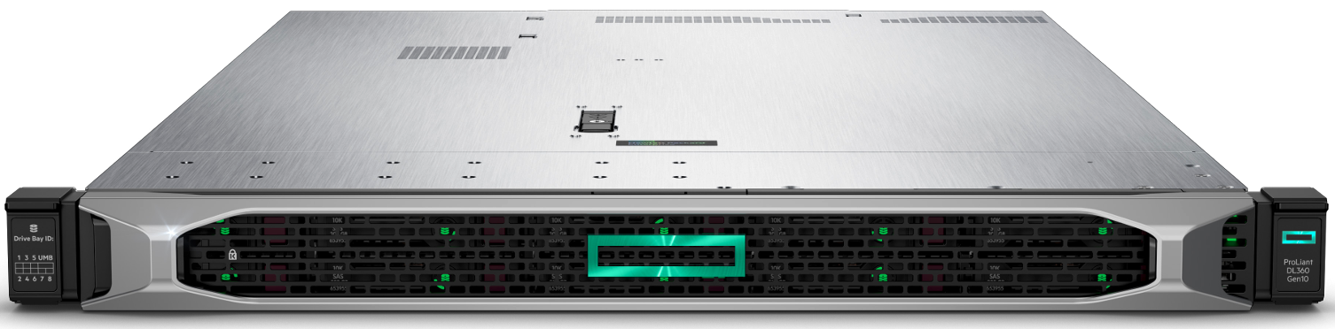






Scope 2 & 3: Example with a Server HPE ProLiant DL360 Gen10
kWh per year
1370 kWh
Manuf
Raw material
Usage
SCOPE 2
PUE
1.5
1.1
End of life
Transport and Distribution
Kg CO2 per kWh
0.275
0.402
0.311*
estimation
565
Kg CO2
Per Year
826
Kg CO2
Per Year
468
Kg CO2
Per Year
SCOPE 3
744.5 kg CO₂e
https://www.hpe.com/psnow/doc/a50004545enw
https://www.eea.europa.eu/data-and-maps/daviz/co2-emission-intensity-12#tab-googlechartid_chart_11
Notes:
Eksempel med en DELL server… Dataene kommer fra DELL!
Det er mye før vi kommer til USAGE som er scope 2!!!
Raw material
Manufacture
Transport
Usage (ikke scope 3)
EOL
Samme server ødelegger mindre i Norge!!!
Holde på servere, eller kjøpe ny servere for å få bedre SCOPE 3 / 2

Slide 8
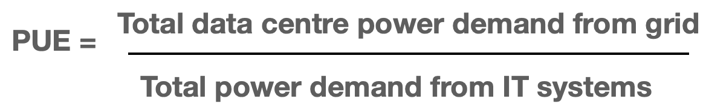
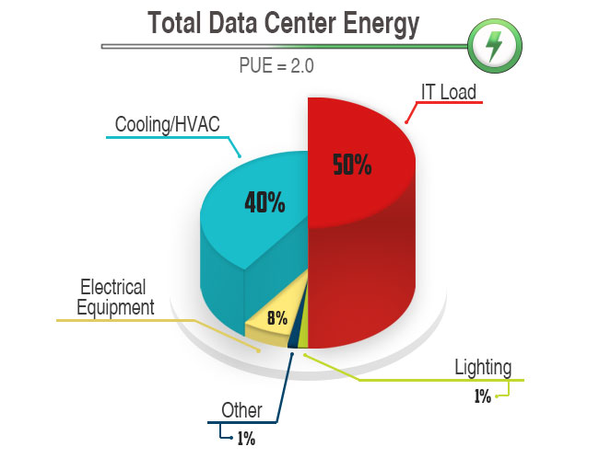
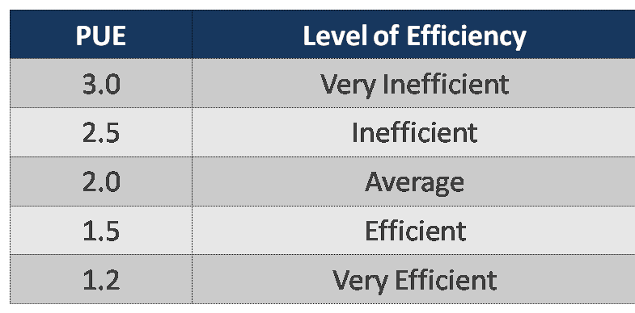
Scope 2: Data Center Power Usage Effectiveness (PUE)
https://www.iso.org/standard/63451.html
Notes:
PUE: Power Usage Effectiveness
For every kilowatt consumed of servers you need cooling

Slide 9




How are Companies reducing their CO2 emissions?
Company X
BU A
App 1
App 2
BU B
App 3
BU C
VM 1
App 1
VM 3
VM 4
VM 1
VM 2
VM 2B
We have ambitions!
Where to start?
Where to start?
Where to start?
Notes:
Often companies have ambitions
A serious company has depts/BU’s
Two different containers/VMs
Different population involved
devops, business, etc
Alle er en del av ambisjonen
HOW do they measure?
WHERE do they start?
We can help with measruing and KPIs
New servers
consolidation
Shut down / power off schema
Kill apps not needed for business
All need visibility and transparancy

Slide 10


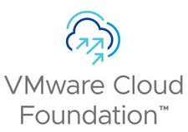
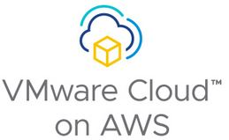
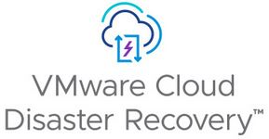
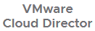
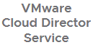


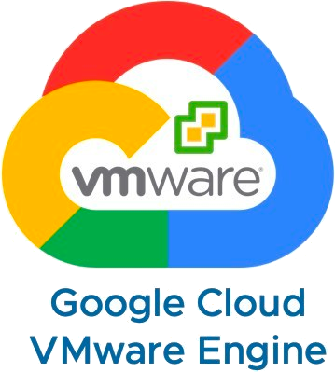


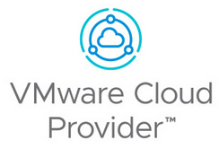

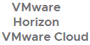
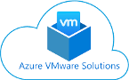
VMware Solutions Support Cloud Sustainability Journey
VMware Cloud
On DellEMC
Google Cloud
VMware Engine
Higher Utilization Data Center
Consolidation
Migration
Hardware Upgrades
Storage and Networking
Consolidation
Hybrid Cloud & Renewable
Energy Powered Clouds
Server Consolidation
Higher Utilization
Virtualization
Environment Optimization
Virtualized Storage & Networking
Private/Public Cloud Sustainability
Zero-Carbon Clouds
Notes:
Virtualization cuts infrastructure needs, reducing energy and carbon footprint. By consolidating host infrastructure (vSphere), storage, and networking infrastructure (vSAN/NSX), optimizing environments for higher utilization (vROps, VCD/VDCS), creating on-premises private cloud environments (VMware Cloud Foundation), and facilitating workload migrations (HCX).
Our multi-cloud solutions boost sustainability by optimizing usage, consolidating resources, and tapping into renewable energy. Multi-Cloud Solutions help by eliminating on-premise infrastructure (Horizon Cloud), leveraging renewable energy-powered public clouds (VMware Cloud Providers), reducing the need for backup data centers (VMware Cloud Disaster Recovery), and running workloads in energy-efficient data centers with renewable energy sources (GEC, VMC on AWS, AVS).
Virtualization enormously reduced the infrastructure customers needed to run their workloads which greatly reduced their energy and carbon footprint.
And now, adoption of our suite of multi-cloud solutions can help our customers continue their sustainability journey.
These solutions enable customers to achieve higher utilization; further consolidate and eliminate storage and networking infrastructure; facilitate server upgrades and data center migrations and consolidations; significantly reduce business continuity and disaster recovery infrastructure; and leverage renewable energy-powered public cloud solutions.
Adoption of our suite of multi-cloud solutions can help our customers on their sustainability journey. These solutions enable customers to achieve higher utilization; further consolidate and reduce compute, storage and networking infrastructure; facilitate server upgrades and migrations to more efficient servers and data centers, and facilitate data center consolidations; significantly reduce business continuity and disaster recovery infrastructure; and leverage renewable energy-powered public cloud solutions.
Virtualization enormously reduced the infrastructure customers needed to run their workloads which greatly reduced their energy and carbon footprint.
And now, adoption of our suite of multi-cloud solutions can help our customers continue their sustainability journey.
These solutions enable customers to achieve higher utilization; further consolidate and eliminate storage and networking infrastructure; facilitate server upgrades and data center migrations and consolidations; significantly reduce business continuity and disaster recovery infrastructure; and leverage renewable energy-powered public cloud solutions.
Infrastructure consolidation -> lower cost -> less infrastructure -> less energy -> less carbon
vSphere consolidates host infrastructure (compared with no virtualization)
vSAN/NSX consolidate storage and networking infrastructure
vROps and VCD/VDCS – help customers optimize their environments for higher utilization and productivity, providing further host consolidation
VMware Cloud Foundation (VCF) creates on-premises private cloud environments to help customers maximize the productive use of their infrastructure providing further IT infrastructure consolidation.
HCX can facilitate migration of workloads to more efficient IT infrastructure, more efficient data centers, public/private clouds, and data center consolidation.
Horizon Cloud – eliminate on-premise infrastructure to support Horizon. Move to more efficient, renewable energy powered public cloud (VMC/AWS)
VMware Cloud Providers – Zero Carbon Committed providers that can provide customers with energy-efficient and low-carbon cloud operations for their workloads.
VMware Cloud Disaster Recovery – reduce or shut down on-premise backup data centers and shift backup capacity to VMC which requires significantly less infrastructure and is renewable energy powered.
GEC, VMC on AWS, AVS – workloads running in more energy efficiency data centers/IT infrastructure + renewable energy powered

Slide 11


VMware Sustainability Portfolio & Roadmap
Innovations enabling customers to achieve their carbon reduction goals
GREEN Infrastructure
Private Cloud (SDDC)
Decarbonization though Virtualization - Compute, Storage, Network
(vSphere, vSAN, NSX)
Multi-Cloud
Enhanced Power Mgmt (vSphere)
Zero Carbon Committed (50+ VCCP Partners: AWS, GCP, Azure…)
Renewable Energy Powered Clouds (24/7 Match & Demand Shifting)
Private/Public Cloud
Hardware Accelerators (AI/ML Workloads)
Energy Savings through Migrations, Consolidations, DR (VCF, HCX, Horizon Cloud, DRaaS)
Telco Energy Savings (VMware RIC)
Available Now
Near Term*
Longer Term*
GREEN Operations
Reuse Idle Hardware Resources (AI/ML Workloads)
Decarbonization Assessment (Carbon Calculators)
Data Center Green Score & Recommendations (Aria Ops)
Software Carbon Intensity (Aria Ops for Applications)
E-Waste Mgmt for Circular Economy (Workspace One)
Data Center Sustainability Dashboards
(Aria Ops)
Multi-Cloud Green Ops (Aria Cost / Cloud Health)
* Near Term is within 1-2 years; Longer Term is 2+ years
Notes:
Our Customers are looking to VMware for Sustainability-Driven Products to reduce energy & carbon emissions across their Operations.
We’re positioned very well to meet their immediate needs, and partner with them on future regulatory requirements and their longer term Net Zero goals.
Here is a snapshot of Sustainability Portfolio and Roadmap – from sustainability evaluation tools in the Sales cycle, to what’s available Now, and upcoming features and innovations.
Our solutions span both the Green Infrastructure (from Data center to Network & Edge) to Green Operations – the day-to-day activity focused on carbon transparency and efficiency.
On the Green Infrastructure side,
We continue to see strong customer success in the Private Cloud and virtualization across compute, storage and network.
In shifting to the multi-cloud, we’ve launched Zero Carbon committed for our VCPP partners with 100% public Renewable Energy commitments – matching them with customers committed to SBTs.
Longer term, we’re focused on our Telco use case in particular to address the demand there.
We’re also exploring how Renewable Energy Powered clouds can peform workload demand shifting and a 24/7 match)
On the Green Operation swim lane,
We’ve spent the last year developing out Green Operations solutions to provide transparency and efficiency - from Aria Ops Sustainability Dashboards to Green Score.
Longer term, we’re exploring how new advances in AI/ML can help drive sustainability solutions for hardware accelerators and idle hardware resources.
As you can see, we are positioned well to help customers today especially AND we have funding and commitment from the BUs to continue developing out our Sustainability Innovation Roadmap.
<For Sales Training> Today – my team will cover this Product roadmap in more detail, including customer examples and case studies. Please do let us know if you have ideas or other customer interest.
<For Broadcom> - the ESG Office continues to drive the Sustainability Product roadmap across VMware with the BUs, and deliver Sales Enablement and training to meet our growing customer needs.

Slide 12
How can Vmware help?
Part 2

Slide 13
Sustainability Maturity Model
Efficient
Provider
Eco-friendly
Partner
Green
Enterprise
New Business
Models
Operating Model Maturity
Change
“IT and business convergence for developing and delivering digital sustainable models“
“Provide on-demand business aligned applications and services with quality to increase agility”
Drive
Efficiencies
“Consolidate and Assess to better control the environmental impact“
Sustainability Focus
Notes:
SMM Lagd av Vmware
Eff prov: understand, assess, where are you at the moment
Eco friendly: Quick WINS
Green: Possibilities, Operationg model

Slide 14
Sustainability Maturity Model
Efficient
Provider
Eco-friendly
Partner
Green
Enterprise
Vision and Strategy
Transparency
Transparency
Green Energy
Green Energy
Awareness
Efficiency
Efficiency
Green Policies
Green Policies
Virtual DC
Build the Team
Green Automation
Green Automation
Tech For Good
Notes:
Milestones in those three pillars
Where are you on virtualization? It’s a given
80% CO2 emissions. Are you 100% virtualized?
Capacity planning: Virtualization ROCKSTAR!
Quick Win: Increase Consolidatoin rate
Awareness
Where are the customer
Sustainability assessment
Questionaire
Where are DCs? Consolidate ratio
Help to understand where they are regarding consumption
Where do you want to be
Ambition as company
as digital department
Build an internal Green digital team internally
Who are the people in the team
TALK to these people (VP, tech resource)
Transparency;
‘ UK, DE, eller Sweden?

Slide 15
Sustainability Maturity Model
Efficient
Provider
Eco-friendly
Partner
Green
Enterprise
Vision and Strategy
Corp and IT Sustainability Agenda
ESG / CxO Sponsorship
Transparency
Carbon footprint report for IT and Business
Promote and educate on the digital sustainability concepts
Green Energy
Low Carbon Energy powering DCs and Clouds
Net Zero targeted rather than Carbon neutral
Awareness
Inventoried HW and SW
Energy consumption assessment
CO2e emission assessment
IT Carbon footprint assessment
Efficiency
Energy and CO2e live monitoring
Facilities rationalization
HW and SW optimization
Wasted resources reduction
Green Automation
Lifecycle Management: Leases, …
Green SLA (Smart shutdown, …)
Smart DR and Backup
Virtual DC
Virtualized Assets
Configuration Management
Performance Monitoring
Capacity Planning
Build the Team
Identify Green Champions and Stakeholders
Customize an E2E IT Sustainability Plan
Green Policies
Green First
Carbon accountability
Sustainable HW and SW policy
Tech For Good
Notes:
Build the team:
Facilities, Ops, Apps, BU, Buyers …
RACI
Efficiency:
HW optimization:
HPM/DPM
WASTE:
Reduce VMs In private Cloud
Orange: 1800 a/year
Efficiency:
PUE, not easy. Related to the datacenter
(takes time and money)
“Give Choice: Multi cloud, VCPP, Locations
Transparency;:
provide carbon footprint report
understand Power consumption
at a virtualiszation layer
This business unit is consuming,,,
pr. Dept
Green policies:
What can a company do?
virtulaziation first?
cloud first?
GREEN first!!!
every new workload should go to a green location
budget on carbojn emissions
policies for hardware and software (Dell, HPE, reduce Scope 3!!!)
Green Automation:
Financial Savings
Green team, not just the DC team
VM Lease
Green SLA
Backup needed or not
DRP needed or not
In the public cloud: Dynamic? Does not power off, Delete shut down. Everything online all the time
Make a Green Offering. Power off Developer servers every night!! Not necessary to keep the lights on at all time
LifeCycle
Green Automation:
Smart DR and Backup:
Measure and apply to App owners the RPO and RTO impact on Carbon emissions
Green Policies:
Green-first approach
Placement on high carbon DC is the exception and need to be approved (latency, compliance, cost, …)
Eco friendly buying and end of life
Second hand HW
Extended lifetime for servers, storage, laptops, end user devices
End of life mgmt with recycling
Extend software support
Carbon accountability:
Carbon reduction target at Team or department level
Quaterly review of optimization (refactor, replatform, Rehost, retire, Redesign, Waste hunting, …)
Carbon visibility for all new projects beyond X€
This section aims to assess what organizational management policies and goals are in place relating to sustainability. To qualify, policies should be documented with processes in place to ensure implementation (training, tracking, assessment).
Host energy management policy means that host energy management is activated across an organization's host fleet as a policy.
E-waste management policy ensures that a company's decommissioned electronic equipment is recycled by vendors in a manner that is socially and environmentally responsible (e.g., eStewards certified, RIOS or equivalent).
Supplier requirements mean that the customer has specific language in its RFPs and contracts relating to energy efficiency and carbon reduction requirements for the product/service provided for its major suppliers, e.g., suppliers representing >75% of annual spend.
Renewable energy goal includes procurement of renewable energy sourcing
Goals require that there is a quantifiable goal in place for a specified part of the organization (e.g., company-wide, regional) with a target timeframe to achieve the goal.
To qualify as "public", goals should be stated in a public forum, (e.g., website, annual report(
Science based target is a commitment by a company to reduce carbon emissions in alignment with a global goal to limit warming to 1.5 C above pre-industrial levels.
Low carbon energy siting policy refers to inclusion of a site's electricity carbon intensity as a key criteria site selection for a new data center (new construction or outsourcing to a third-party data center provider, e.g., colo). This can include the consideration that a data center provider has a renewable energy goal and/or is renewable energy powering their facilities.

Slide 16
Sustainability Maturity Model
Efficient
Provider
Eco-friendly
Partner
Green
Enterprise
Aria Operations
Vision and Strategy
Transparency
Green Energy
vCDR
Awareness
Efficiency
Green Automation
TAM
Virtual DC
Build the Team
Green Policies
Tech For Good
vSphere / VCF
Aria Operations for Apps
vSphere / VCF
Aria Cost
VMC on AWS,
GCVE and AVS
Aria Automation
Notes:
LOVE:
Our products>what does it do>What is the value proposition towards Sustainability
WE need to bring some numbers behind this
CLOUD ECONOMICS TEAM!

Slide 17
Driving Sustainability

Slide 18


VMware Cloud Foundation
Private/Public Cloud Sustainability
Facilitates higher host/cluster utilization
Reduction in physical infrastructure (server, storage & networking)
Reduction in DC rack space and cooling load
90% reduction in energy & carbon* (compared to basic virtualization)
* customer specific case study

Slide 19

VMware vSphere
Virtualization
Many environments are under-utilized
Host Power Management can be implemented risk-free
Distributed Power Management is becoming en vouge
HPM and (scheduled) DPM saved 11% of energy*
* customer specific case study
Notes:
Customers have bought too much
Not a problem for us

Slide 20

VMware Aria Operations
Environment Optimization
Optimize physical resource utilization
Capacity planning to prevent excess hosts
Energy transparency and accounting
Sustainability Dashboards since 8.6 (2021)
VMware Green Score since late 2022
Identified and remove 1000s of “Zombie” VMs*
* customer specific case study

Slide 21

VMware vSAN
Virtualized Storage & Networking
Reduction in external storage arrays, file servers, DC rack space and cooling load
56% reduction in energy & carbon emissions* (per year)
* customer specific case study

Slide 22

VMware HCX
Private/Public Cloud Sustainability
Enables DC migration and server upgrade
$3M annual savings* 27% reduction in servers* 68% reduction in racks*
66% reduction in annual energy usage*
* customer specific case study
Notes:
Logo svg https://www.martingustafsson.com/vcf-ui-json/

Slide 23
VMware Cloud on AWS
Zero Carbon Clouds
Efficient hardware and DC operations
Renewable powered, low PUE DCs
47% reduction in hosts count*
88% reduction in carbon emissions per year*
* customer specific case study
Notes:
VMC has a great sustainability story. When a customer moves their workloads to VMC, they need much less hardware in the cloud than on premises, and that VMC hardware is more energy and carbon efficient, so is the VMC data center. And, it is renewable energy powered. In one case study, the customer had an 88% reduction in carbon emissions per year.
Reducing carbon footprint of on-premises IT hardware by leveraging an on-demand or Pilot Light DR cloud infrastructure based on VMware Cloud on AWS. Coupled with the on-demand scaling of compute resources in minutes. Hence avoiding unused capacity on-premises and provisioning resources depending on RTO requirements.
Reducing carbon footprint of DC heating, ventilation, and air conditioning (HVAC) through a cloud provider that uses world-class facility designs, cooling systems, and workload-optimized equipment.
VMware Cloud hosted on AWS is powered by renewable energy with a goal to reach 100% by 2025.

Slide 24

VMware Cloud Disaster Recovery
Zero Carbon Clouds
Reduced backup capacity infrastructure
Renewable powered, low PUE DCs
45% reduction in carbon emissions per year*
* customer specific case study
Notes:
VMC has a great sustainability story. When a customer moves their workloads to VMC, they need much less hardware in the cloud than on premises, and that VMC hardware is more energy and carbon efficient, so is the VMC data center. And, it is renewable energy powered. In one case study, the customer had an 88% reduction in carbon emissions per year.
Reducing carbon footprint of on-premises IT hardware by leveraging an on-demand or Pilot Light DR cloud infrastructure based on VMware Cloud on AWS. Coupled with the on-demand scaling of compute resources in minutes. Hence avoiding unused capacity on-premises and provisioning resources depending on RTO requirements.
Reducing carbon footprint of DC heating, ventilation, and air conditioning (HVAC) through a cloud provider that uses world-class facility designs, cooling systems, and workload-optimized equipment.
VMware Cloud hosted on AWS is powered by renewable energy with a goal to reach 100% by 2025.

Slide 25

Quote Slide: Leaf and Ocean Color Theme
ZF are currently investigating the optimization of Host Power Management features of their entire infrastructure. Hosted VMware to talk for 4 hours to 300 employees about sustainability.
ZF Friedrichshafen

Slide 26
What can be done?
What WILL we do?
Investigate, Propose, Do
Turn Off, Don’t run it…
Optimize
VMs
Hosts (aka: Give DPM a 2nd chance)
Seriously
Search and Destroy Zombies
Life Cycle optimizations
Host Power Management
For Transparent Page Sharing
VM Memory Size, #RightSize
Utilize low-risk Power Management
It’s not all in or all out
Transparent Page Sharing (TPS)
If performance / security allows

Slide 27
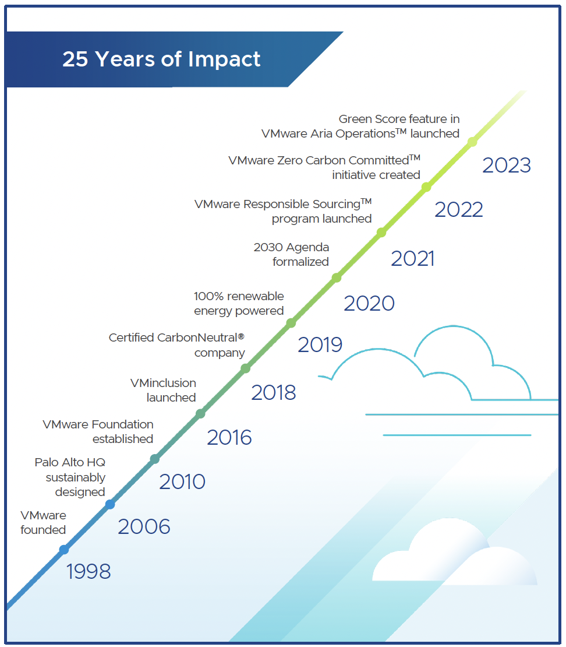
VMware ESG Report 2023 – Smart Impact
2.5 decades of impact on Sustainability with VMware solutions
Engineering a more sustainable multi-cloud, reducing emissions footprint towards achieving net zero.
A competitive advantage for VMware that will define our future as surely as virtualization defined our beginnings.
Notes:
ESG is a competitive advantage for VMware that will define our future as surely as virtualization defined our beginnings. Because in the multi-cloud era, empowering digital innovation and building a more sustainable, equitable and secure world are the same goals.

Slide 28
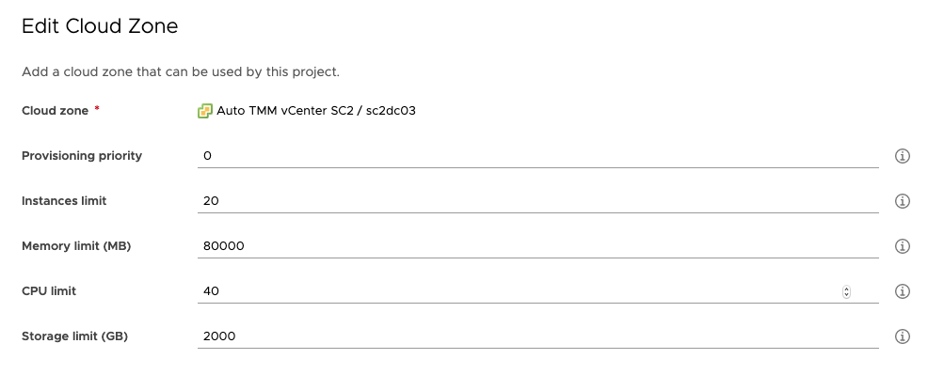
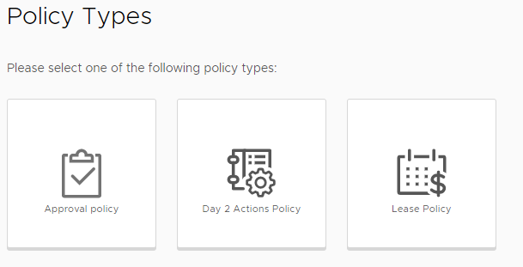
Governance and Policies
Resource Limits
Approval for requests
Leases (control lifetime of objects)
Cost visibility
Manage resource utilization

Slide 29
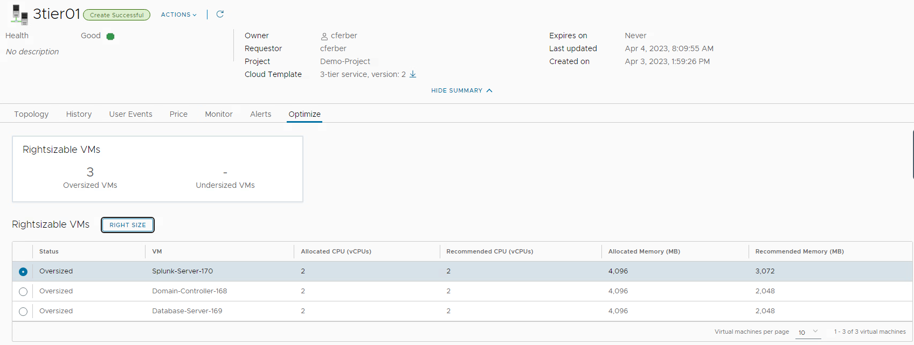
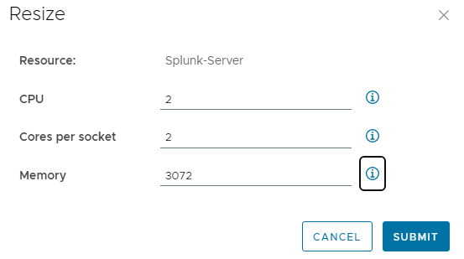

Resource optimization
Consumer
Visibility of resource consumption
Alerting
Recommendations for optimization
Execution of Rightsizing actions
Leveraging

Slide 30
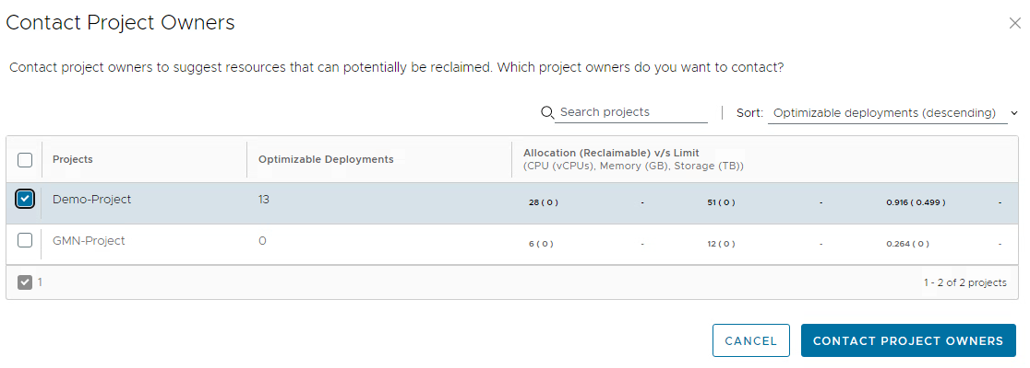
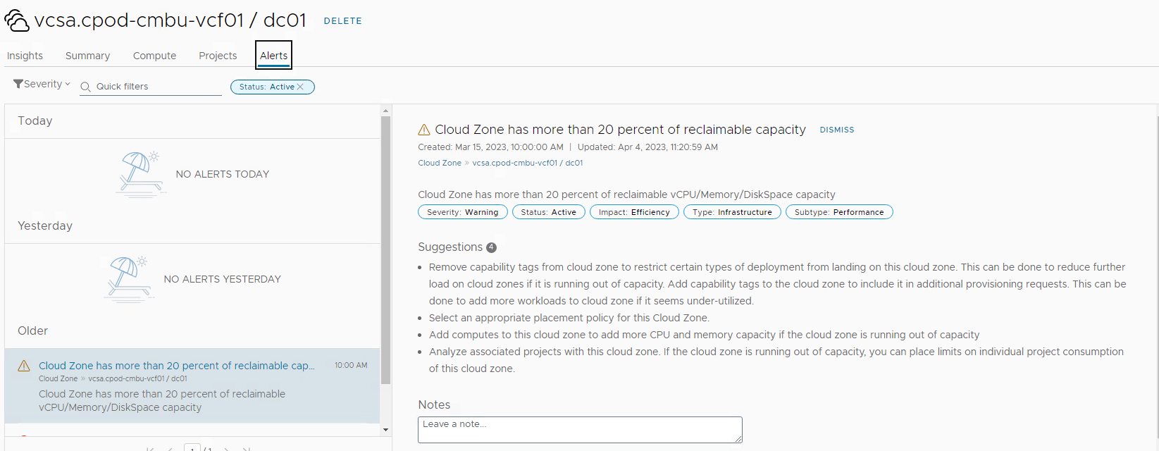
Resource optimization
Provider
Visibility of overall resource usage
Alerts
Notification to project owners

Slide 31
Ensuring Compliance

Slide 32
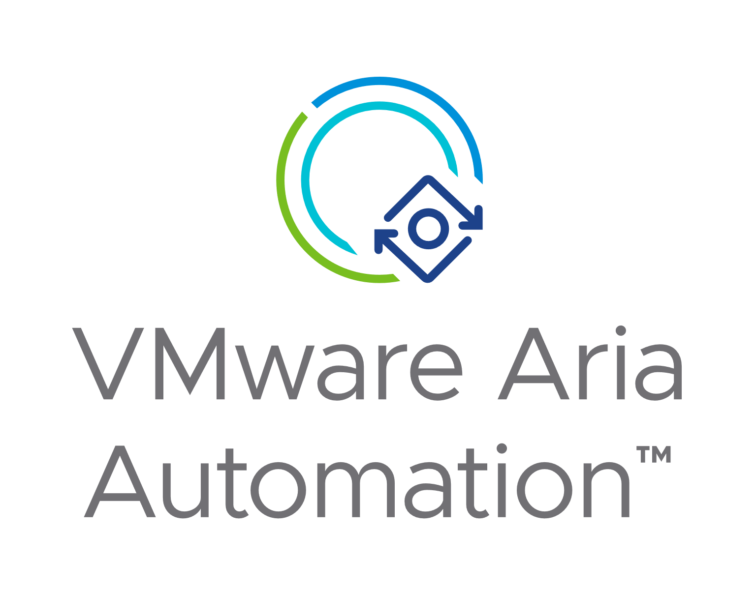
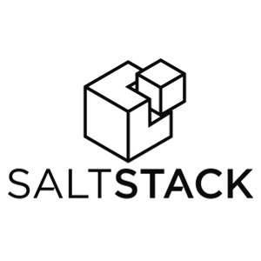
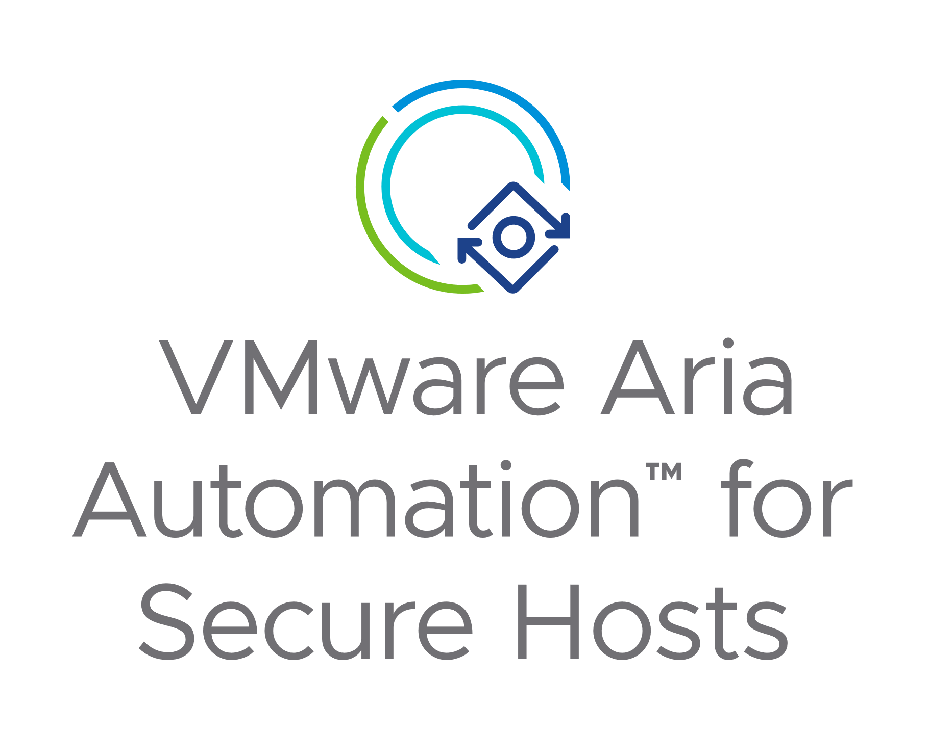
Configuration and Compliance Management
request
Aria Automation
service ready
Infrastructure-as-Code
Versioning
Source-code-management
Desired state model
Guest OS management
OS configuration / application
Configuration management
Desired state model
Compliance against CIS standard
Vulnerability management

Slide 33
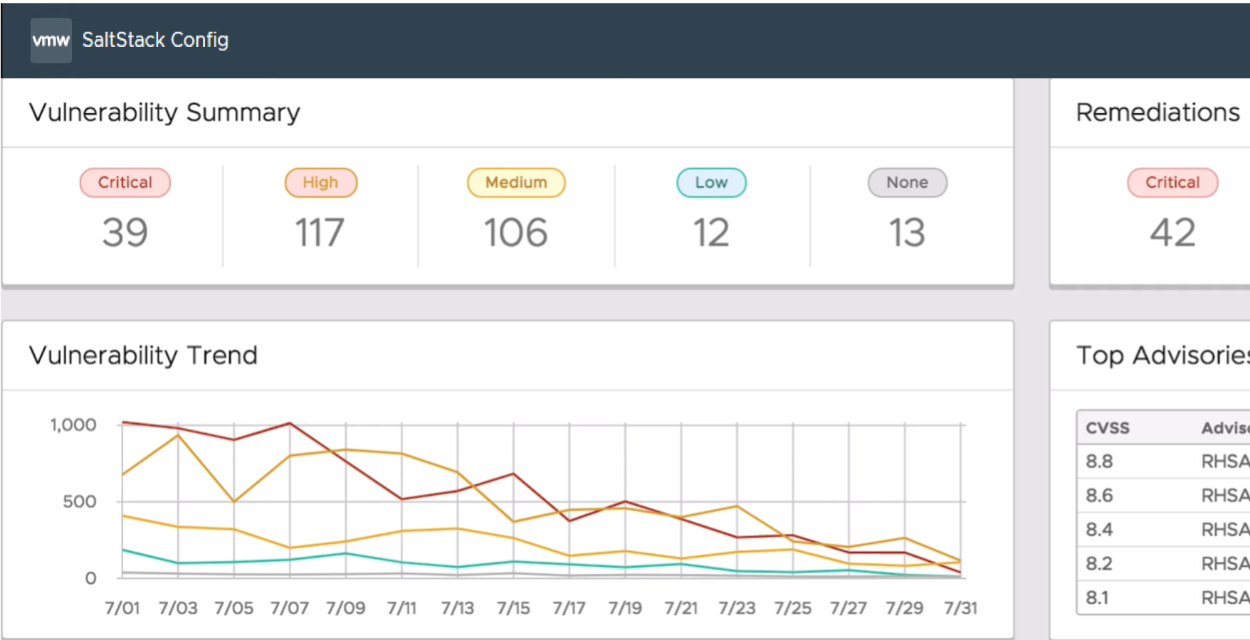
Vulnerability Management
Scan and remediate critical OS vulnerabilities with VMware Aria Automation for Secure Hosts
VMware Aria Automation for Secure Hosts actively ingests vendor CVE advisories, builds scans and remediation workflows to address them, and delivers this security content to customers as a service.
Access a live database of OS security remediation actions
Optionally ingest scans from 3P tools: Tenable, Qualys, Rapid7, Kenna
Prioritize OS vulnerabilities and remediate with the click of a button

Slide 34
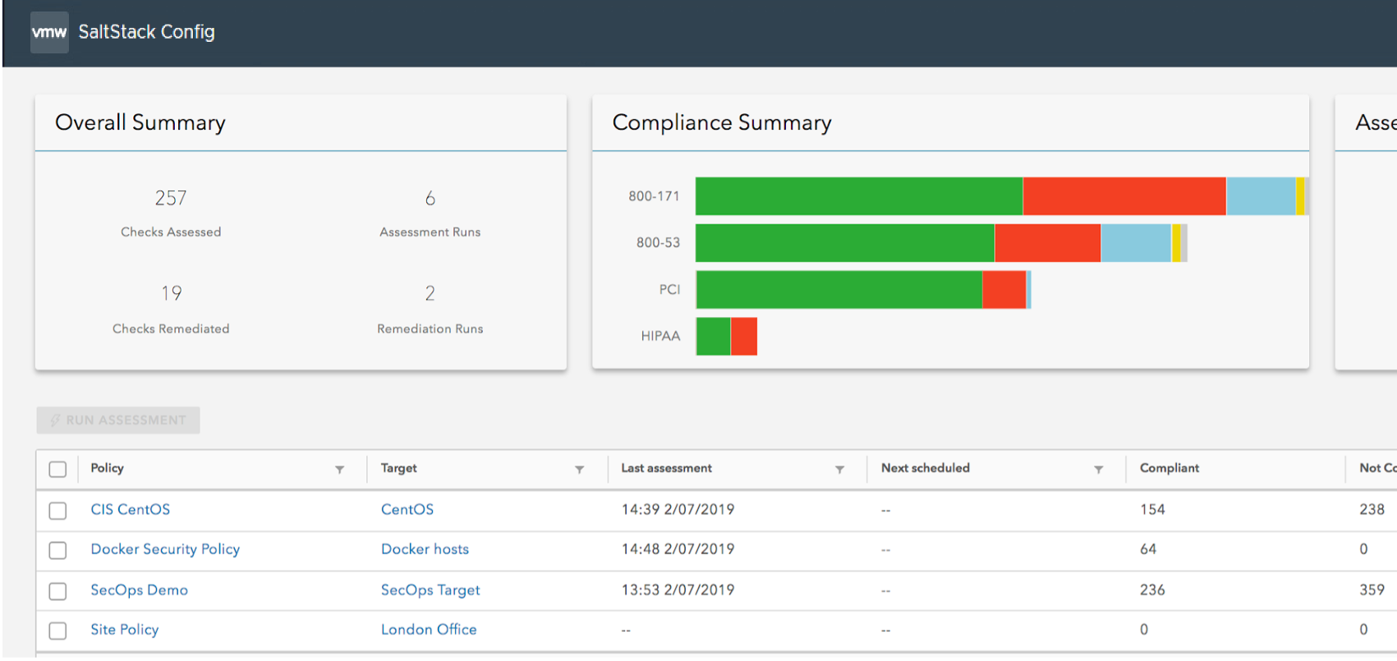
Continuous Compliance Enforcement
Automate continuous IT compliance with CIS-certified content
VMware Aria Automation for Secure Hosts actively detects and fixes compliance drift with automated remediation—saving resources, improving security posture, and reducing risk.
Access a live DB of certified CIS and DISA STIGs scans and remediations
Create jobs for review and approval before changes are executed
Actively detect and remediate compliance issues with pre-built automation

Slide 35

Carbon Transparency with Aria Operations

Slide 36





Unified Operations for full stack
Moving from product-centric to solution-centric
Pillars of Operations
AVAILABILITY
PERFORMANCE
CAPACITY
COMPLIANCE
COST
SUSTAINABILITY
Aria Operations
Aria Logs
Aria Networks
Aria Content
Edge
Data Center
Managed Data Center
VMware on Public Clouds (VMC, AVS, GVCS)
Native Public Clouds

Slide 37

Sustainable Data Centre Operations
3 dimensions of sustainability
Green Supply
Infrastructure that is optimized
Right-size VMs
Reclaim Wastage
Reclaim Hosts
Idle VMs
Optimize Oversized Clusters
Smaller DC footprint
SLA-based Operations
Business-aware Operations
On-Demand scaling
And more….
Clean Demand
Genuine demand of resources by IT or Business
Run Lean
Run with minimal overhead and buffer
Notes:
To implement the above requirements, we need to see 3 aspects of Sustainable Operations:
Clean Demand : This means genuine demand, required by either business or IT. (Opportunity to clean up the demand)
Green Supply : Hardware & Software infrastructure that is optimized (Opportunity to optimize the supply)
Lean Operations : Run with minimal overhead and buffer (Opportunity to optimize the operations itself )

Slide 38
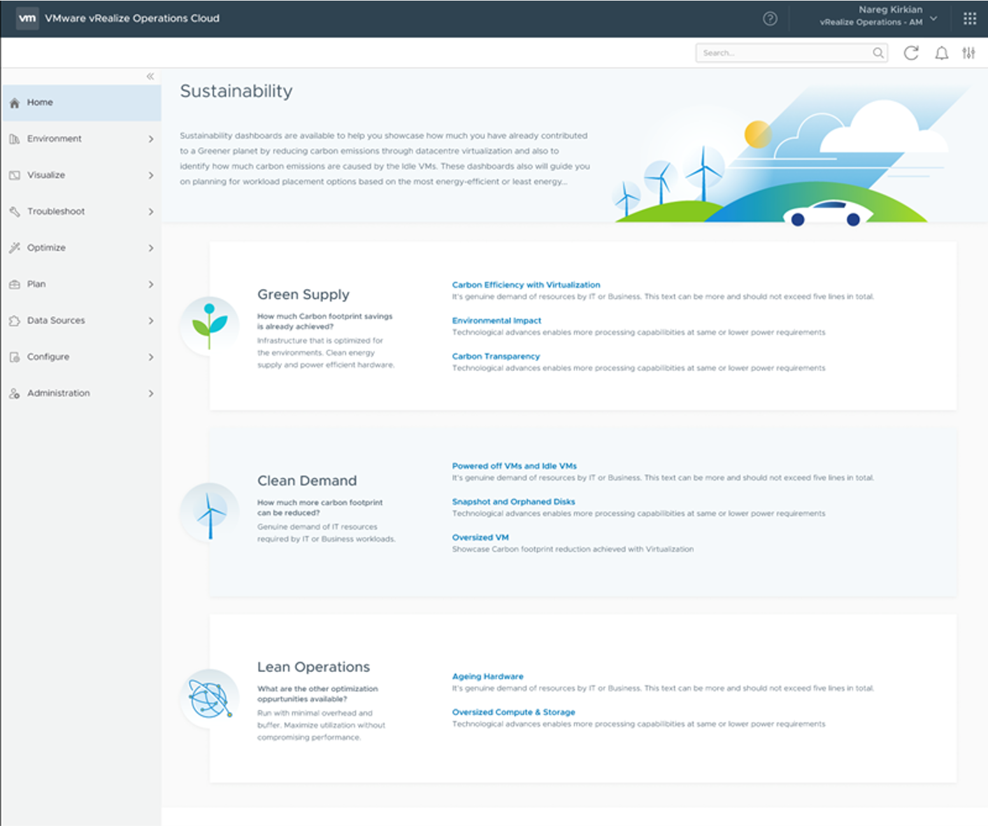
Sustainability Dashboards in Aria Operations 8.6 ( previously vROPs)
Achieve Sustainable Operations
How much CO2 saved by Virtualizing Workloads?
Further CO2 optimization by reducing idle VMs
Identify Greenest Cluster to provision workload
First VMware product with Sustainability story
Sustainability summary page and Four dashboards categorized under dimensions Green Supply, Clean Demand and Lean operations

Slide 39
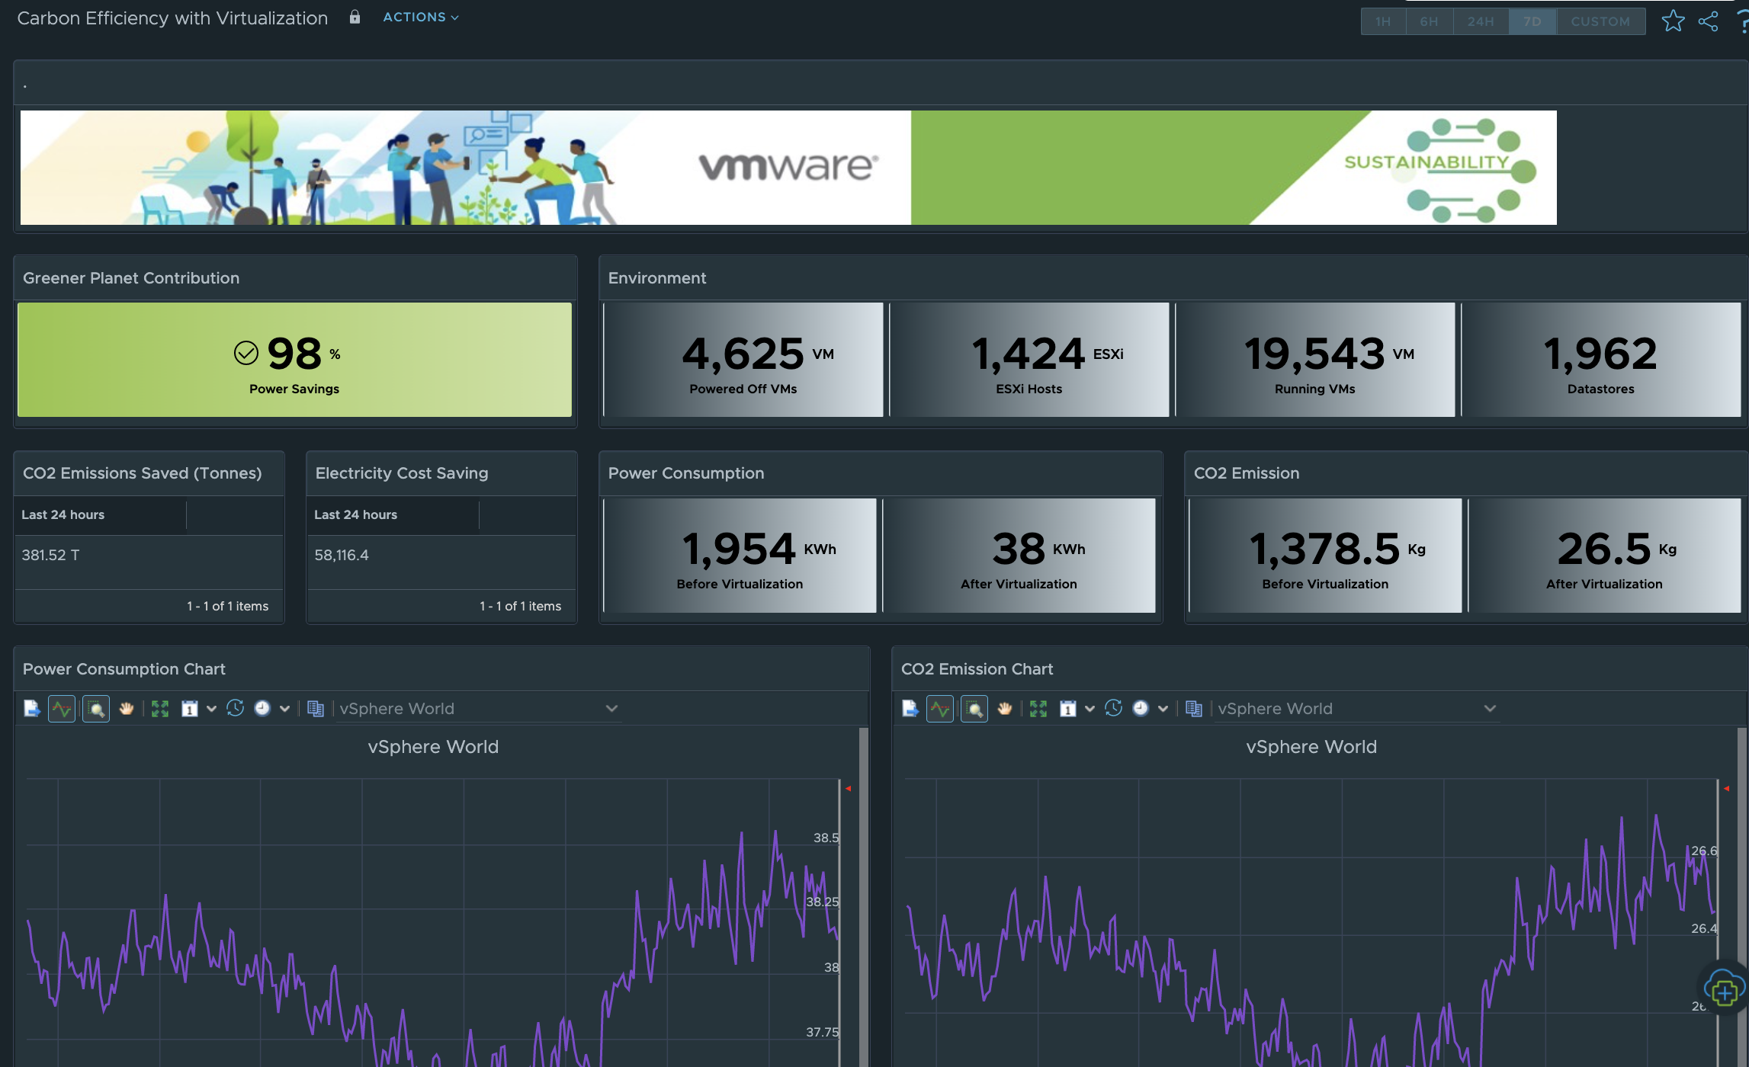
Carbon Efficiency with Virtualization
How much carbon emissions saved with Virtualization ?
How much Carbon emissions were saved by Compute Virtualization ?
Legacy story, but useful for Carbon Reporting
Electricity Cost saved by Virtualization
Carbon Emissions trends over a period of time

Slide 40
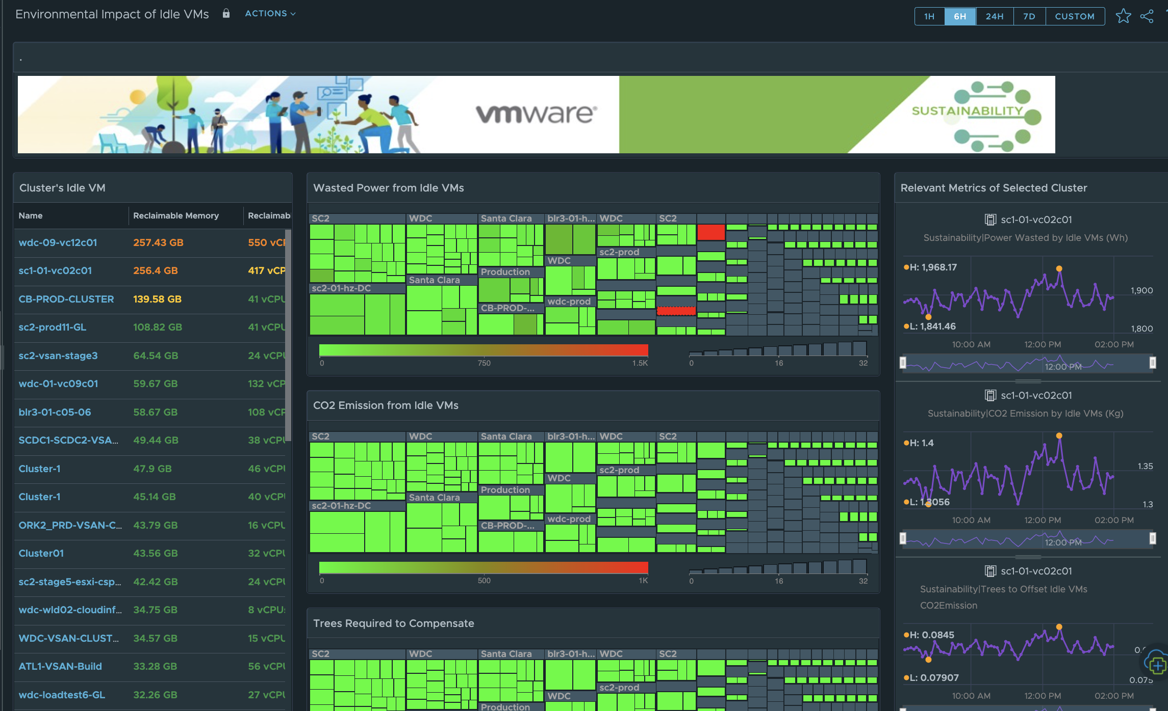
Environmental Impact of Idle VMs
How to optimize current carbon footprint ?
Easy target for reducing carbon footprint from Idle VMs
Identify Power wasted by Idle VMs in cluster
Reduce power wastage by shutting down / Deleting Idle VMs
Identify trees to be planted to offset damage done by Idle VMs

Slide 41
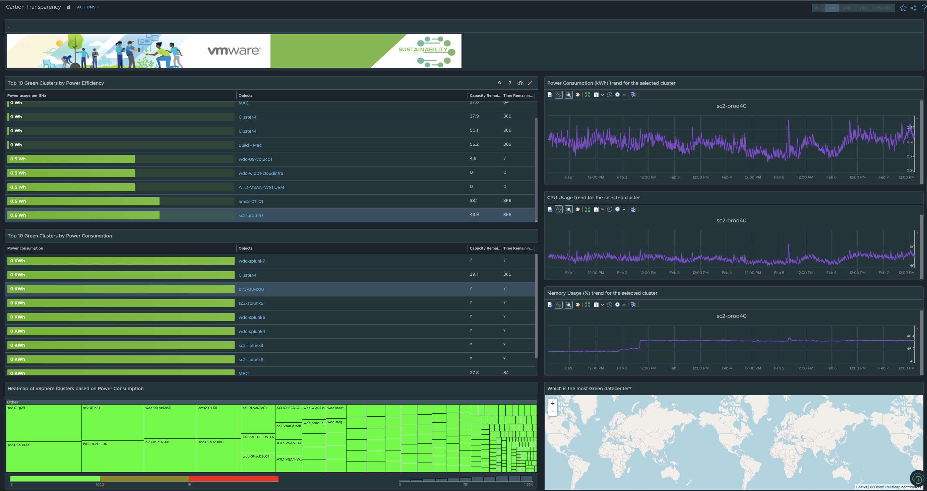
Carbon Transparency Dashboard
Need for identifying the Greenest Cluster to provision next workload
Identify the Greenest Cluster based on “Power Efficiency metric”
Capacity metrics and utilization metrics also available to help decide on where to provision the next workload
Geo Widget mapping cluster across different Geo locations
Heatmap of Clusters to showcase carbon emissions

Slide 42
Tracking Sustainability Goals in the Datacenter with Aria Operations
Story presented at VMworld 2021

Slide 43




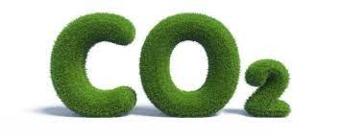
Sustainability Goals and IT Operations
UAE’s Sustainable Development Goals
Dubai Airports – Corporate Responsibility
Pillar # 5 Environment and Sustainability
Carbon-Neutral Growth
Sustainable Datacentres

Slide 44
How much De-Carbonization was achieved by Virtualization?

Slide 45
Environmental Savings Dashboard

Slide 46
Environmental Impact Dashboard – Power Wastage
Identify Wasted Power from Idle VMs
Identify CO2 Emission from Idle VMs
Count of trees to be planted to offset damage from Idle VMs

Slide 47
How much did Dubai Airports contribute to the Greener Planet?
Assessing Carbon emission savings
4149
Tonnes
From VMworld 2021 Breakout Session IC2257
Carbon Emissions avoided since 2016*
*Assuming power consumption of a low range server as 0.1 KW per physical server if not virtualized
Above calculation considers only compute virtualization and actual savings could be lot more considering lesser cooling and datacentre space required after virtualization

Slide 48



Recipe of Success
From VMworld 2021 Breakout Session IC2257
Sustainable Datacentres at Dubai Airports
Compute Virtualization
Storage Virtualization
Energy Efficient Modular datacentre
Network Virtualization
Tracking Carbon Emissions
Tracking Sustainability Metrics
Ensuring Success of Sustainability Goals
Trusted Advisor

Slide 49
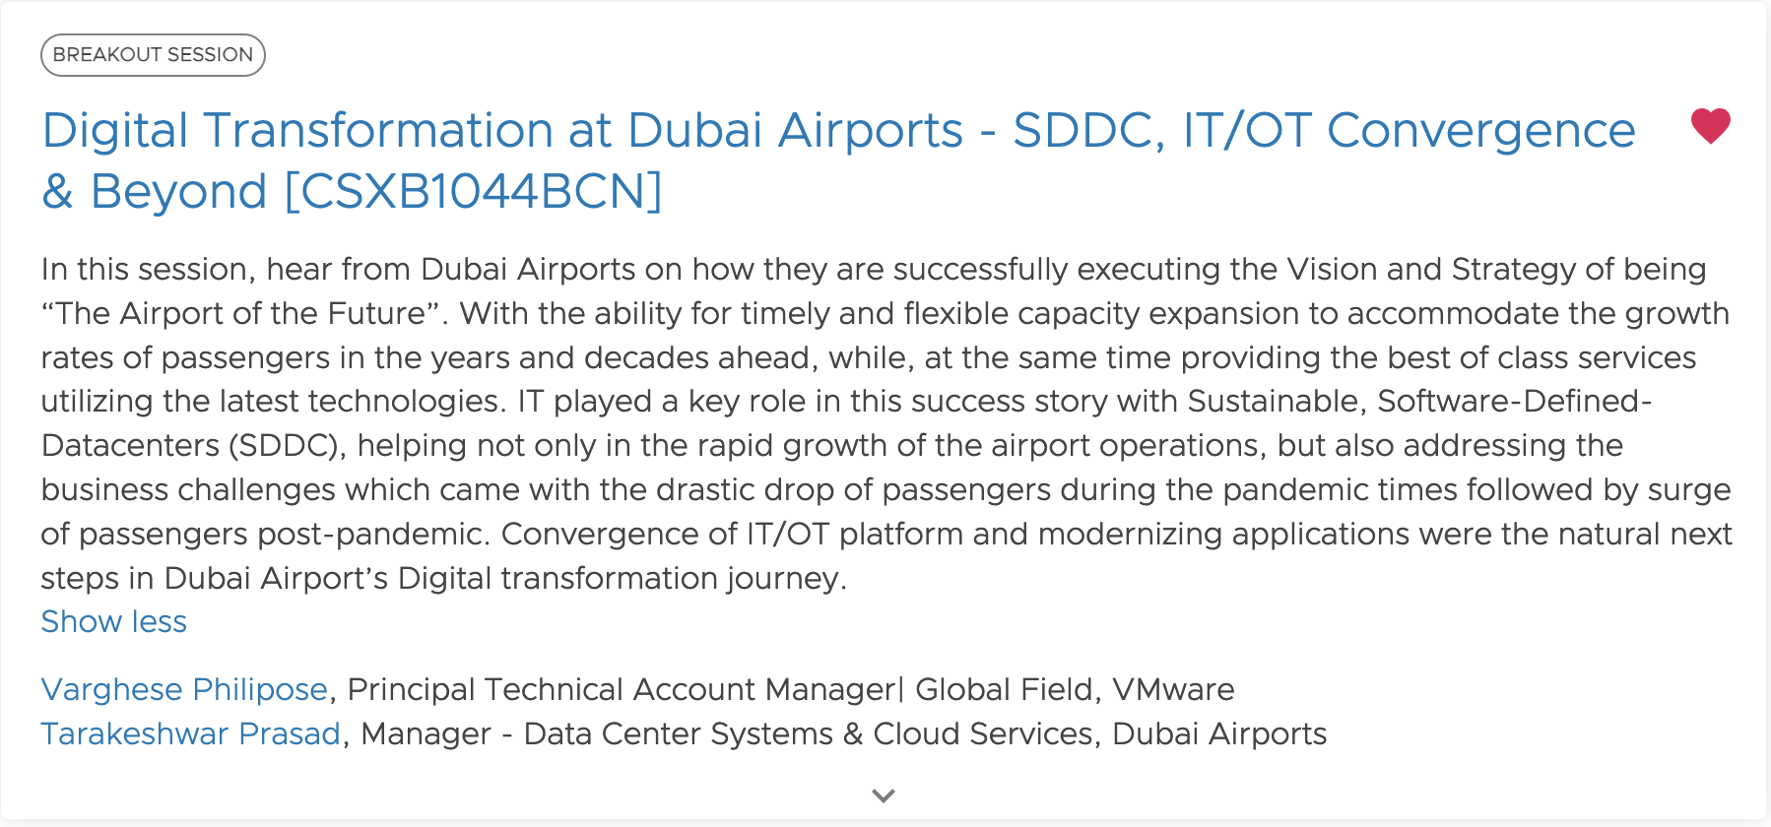
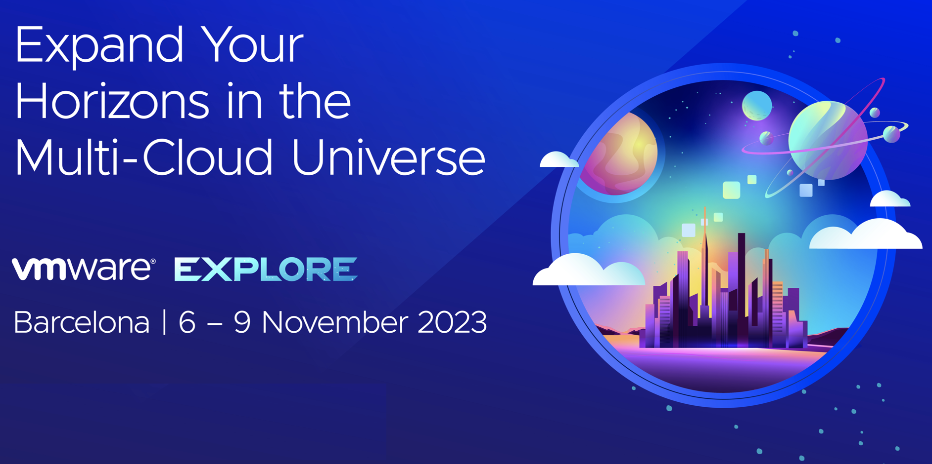
Driving on the Sustainability goals – Next Phase
Hear at VMware Explore Barcelona 2023

Slide 50
Sustainability 2.0 in Aria Operations 8.12
Objective | Deepen customer value by helping achieve their sustainability goals by decarbonizing their digital operations with their current solutions
Key Results | Carbon Visibility: Energy and carbon footprints at VM/ App, Host, Cluster and data centre levels are measured and visible in VMware environments using a consistent methodology
Identify Current Carbon Footprint
Track CO2 emissions reductions – Green Score
Actionable recommendations for improving Green Score

Slide 51
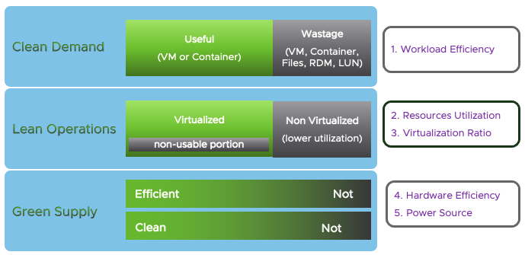
Sustainability or Green Datacenter Operations?
Tracking Green Operations
Notes:
Just because your source of power is green, does not it mean you’re done.
It does not give free ticket to burn as much electricity, generate as much heat, as occupies as much land.
You should still minimize your footprint
Sustainability
It covers areas beyond what VMware addresses. For example, office that is mostly empty is not a good sustainable practice as space is limited. Business travel and daily commute are not green practice.
Conclusion
VMware Green Score should be within VMware’s circle of influence, not circle of concern. Cover what we can make a real difference.

Slide 52
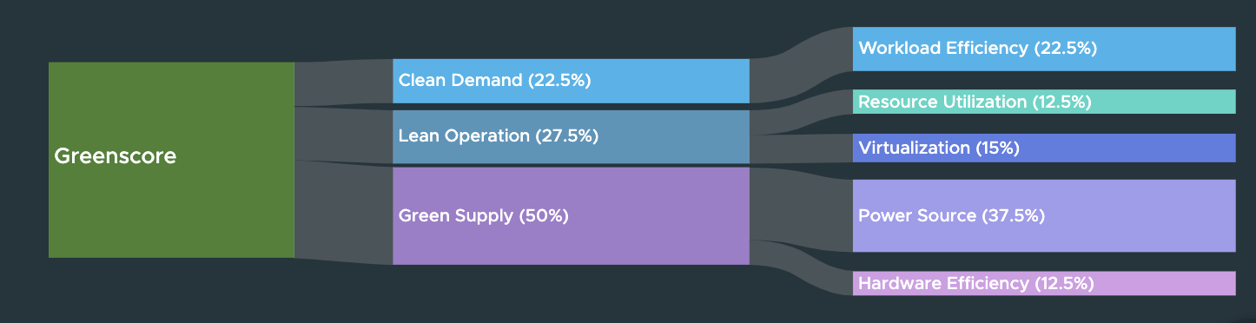
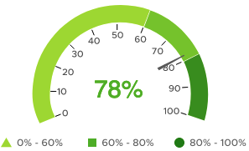
VMware Green Score
A Relative Score to track De-Carbonization journey

Slide 53
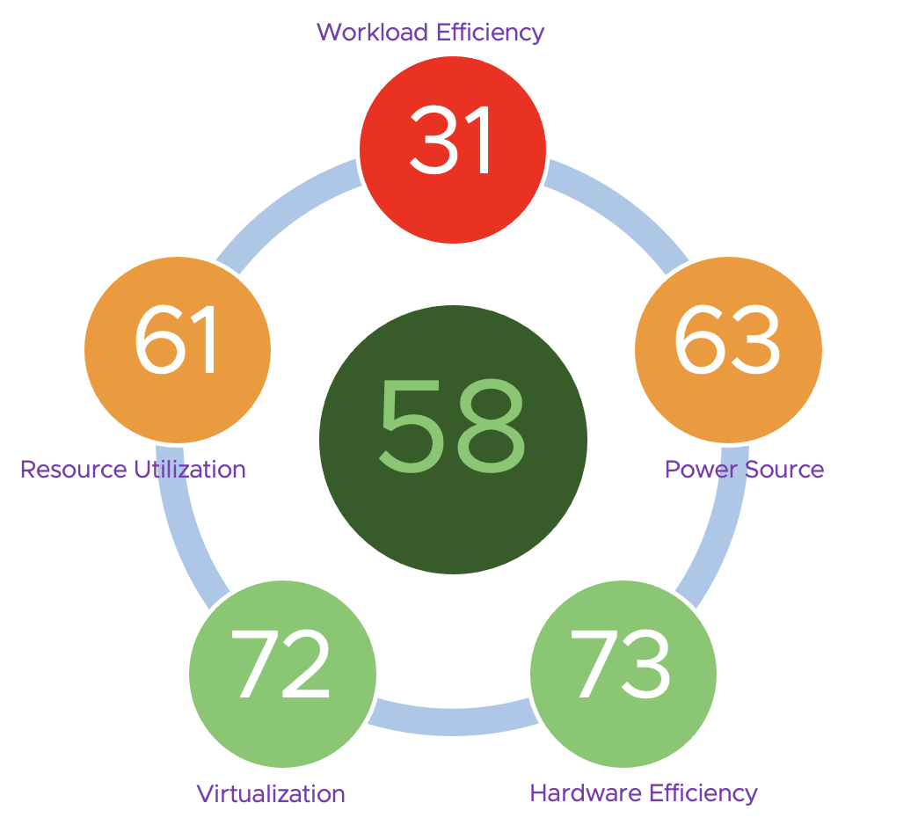
The 5 Components of VMware Green Score

Slide 54
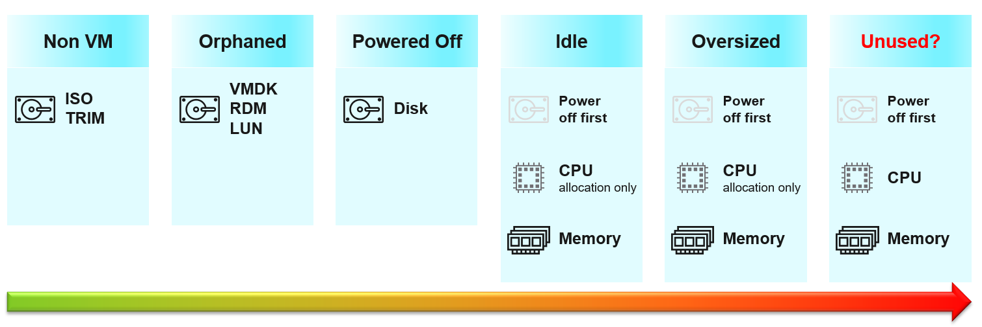
Component 1: Workload Efficiency
Are the workloads useful to the business?
Measures Wastage in the datacenter
Calculates score based on Wastage sources
Efficiency (%) = Non Wastage / (Wastage + Non Wastage)
100% Wastage
Zero Wastage
0%
Workload Efficiency Score
100%

Slide 55
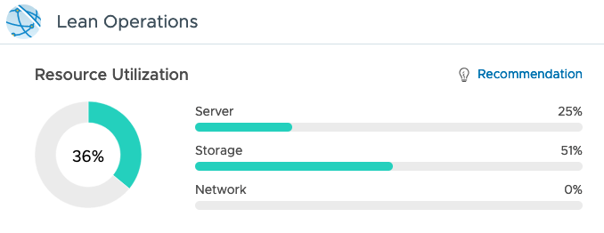
Component 2: Resource Utilization
Reduce buffers and overheads without impacting SLAs
Utilization Measured against
Absolute Capacity values
OBJECTIVE 03
Larger the HA and buffer,
less lean the operations
Recommend the required HA and Buffers ONLY to satisfy Operational SLAs
0% Usage
100% Usage
0%
Resource Utilization Score
100%
Notes:
Consideration: 100% is projected based on actual utilization? If you’re running at 33% and consumes 100W, we assume you waste 200W? This is not technically accurate but fair?

Slide 56


Component 3: Virtualization
Percentage of virtualized physical infrastructure – Compute, Storage, Network & Desktop
0% Virtualized
100% Virtualized
0%
Virtualization Score
100%
Notes:
Consideration: 100% is projected based on actual utilization? If you’re running at 33% and consumes 100W, we assume you waste 200W? This is not technically accurate but fair?

Slide 57


Component 4: Power Source
Scored based on Carbon Intensity per power source
Highest Carbon Intensity - 1000
Zero Carbon Intensity
0%
Power Source Score
100%
Notes:
Reference:
WNA Report - Comparison of Lifecycle Greenhouse Gas Emissions of Various Electricity Generation Sources
For eg: Based on Greenhouse Gas Equivalencies calculator, Power source based on non-renewable sources is 0.709 Kg / KWh – (https://www.epa.gov/energy/greenhouse-gas-equivalencies-calculator)
For environments with different power sources of different Carbon Intensities, normalized average values to be used for calculating Score
Sample scenario :
If Total Power consumption = 1000W where Power Consumption from Coal based Power =600W and Power consumption from Wind based Power = 400W
If Carbon Intensity for Coal based power = 709 g/Kwh and Carbon Intensity for Wind based power = 26 g/KWh and Maximum value for 0% score is 1069 g/Kwh,
Score for Coal based power = (1069-709)/1069 = 33%
Score for Wind based power = (1069-709)/1069 = 98%
Score for the entire environment will be Normalized Average of both scores based on their share of power consumption.

Slide 58

Component 5: Hardware Efficiency
Scored based on the hardware generation
Based on the assumption that new generation hardware will be more energy efficient than the old generation hardware in two ways:
By running more workloads on the same sized hardware
New hardware able to optimize energy consumption.
Hardware
5 years old
Current Generation hardware
50%
Hardware Efficiency Score
100%
Notes:
This is like comparing ICE car with electric car. Disposing the old car costs the environment, buying a new one also costs the environment as that car needs to be created. So it’s best to separate this as there is no end to it.

Slide 59


VMware Greenscore
Measure the Effects of Sustainability Actions
Clean Demand
Workload Efficiency
Lean Operations
Resource Utilization
Virtualization
Green Supply
Power Source
Hardware Efficiency
Notes:
"Greenscore and other indicators are used to assess whether the actions are achieving the desired results.
Composition of the Greenscore.
Even with 100% green power, there are still areas to improve efficiency and sustainability."
Greenscore + andere Anzeigen um beurteilen zu können, ob die Aktionen das gewünschte Ergebnis haben.
Zusammensetzung des Greenscores.
Auch bei 100% green power gibt es noch Bereiche um Effizienz und Nach Nachhaltigkeit zu steigern.

Slide 60


VMware Greenscore
Organization Drivers
Multiple parameters for effective measurement of the VMware Greenscore.

Slide 61


Clean Demand through Workload Efficiency
Find and remove the waste
Find and remove unused resources
Powered off and idle VMs
Snapshots
Orphaned disks
Align the size of Virtual Machines with their true demand.

Slide 62

Automation Central
Self-Driving Optimization
Recurring performance and capacity optimization process.
Control the behavior of your environment.

Slide 63


Lean Operations
Increasing Resource Utilization
Identify oversized and underused vSphere Clusters and Datastores
Buffer- and Admission Control-aware
Use your own Virtual Machine profiles

Slide 64

Workload Balancing
Optimize Virtual Machines Placement across Clusters
Driven by custom Operational and Business Intents
Increase efficiency
Reduce resource contention
Maintain optimum system performance

Slide 65


Green Supply
Hardware Efficiency
Reduce overhead
Find small clusters
Increase efficiency
Technology advancement (compute and storage)

Slide 66

Green Supply
Carbon Transparency
Identify efficient clusters
Energy consumption per CPU GHz provided
Total energy consumption

Slide 67


Green Supply
CO2 Emission Savings
Saved power and avoided carbon emissions
Impact of the virtualization
Customizable parameters

Slide 68

Avoidable CO2 Emissions
Impact of wasted Work
Energy consumed by Idle VMs
Aggregates per cluster
Customizable
Transparent

Slide 69

VMware Green Score

Slide 70

Optimize Green Score – Actionable Recommendations

